Slide 1
Weekly Tasks
Peak Detection on Time Series Sensor Data

Slide 2
Peak Detection on Versuch1_final.csv
The file had 17 features –
Geschw_X_glatt_zwanzig_0;Geschw_Y_glatt_zwanzig_0;Geschw_Z_glatt_zwanzig_0;Geschw_SP_glatt_zwanzig_0;
Beschl_X_glatt_zwanzig_0;Beschl_Y_glatt_zwanzig_0;Beschl_Z_glatt_zwanzig_0;Beschl_SP_glatt_zwanzig_0;
Kraft_X_glatt_zwanzig_0;Kraft_Y_glatt_zwanzig_0;Kraft_Z_glatt_zwanzig_0;Kraft_SP_glatt_zwanzig_0;
removed_material_0;
Current_X_glatt_zwanzig_abs;Current_Y_glatt_zwanzig_abs;Current_Z_glatt_zwanzig_abs;Current_SP_glatt_zwanzig_abs
Delimiter - ‘;’,
Decimal - ‘,’

Slide 3
Created an iterator object to iterate through the data in batches (of 10000 data points).
Implemented functions to calculate the summary statistics on the data and visualize the data using a line plot.

Slide 4
Made use of the function find_peaks available in scipy library.
https://docs.scipy.org/doc/scipy/reference/generated/scipy.signal.find_peaks.html
Implemented functions to extract peaks from all the columns and plot the peak values.
Experimented by considering
values > mean x 2 → Peaks
Created dataframes for every peaks detected

Slide 5
Observations:
No common peaks occur in all four axis of a feature.
Common peaks occur among the following pairs:
Geschw & Beschl
Geschw & Current
Beschl & Current
Over all the axes.

Slide 6
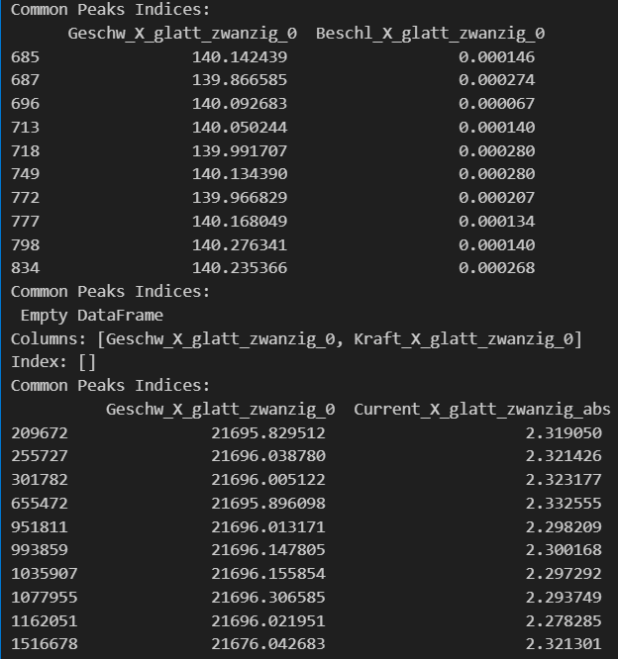
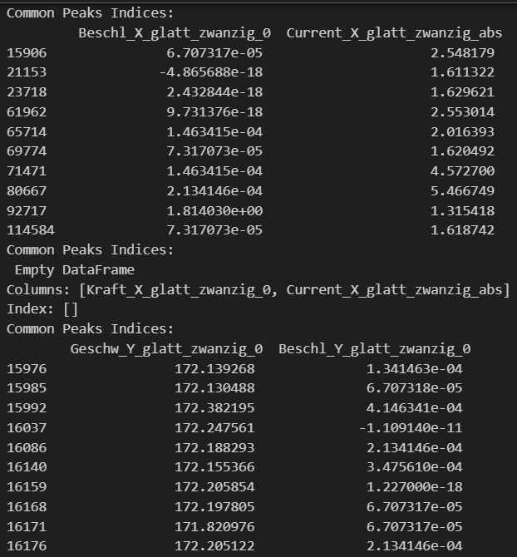

Slide 7
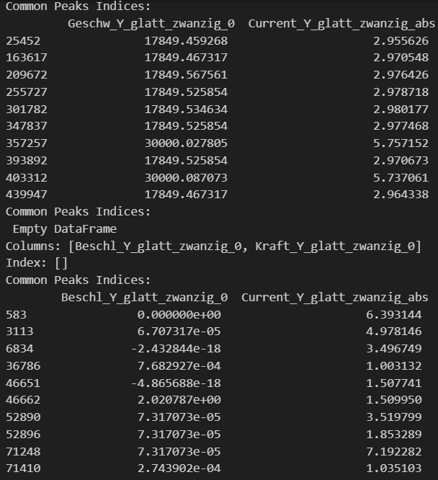
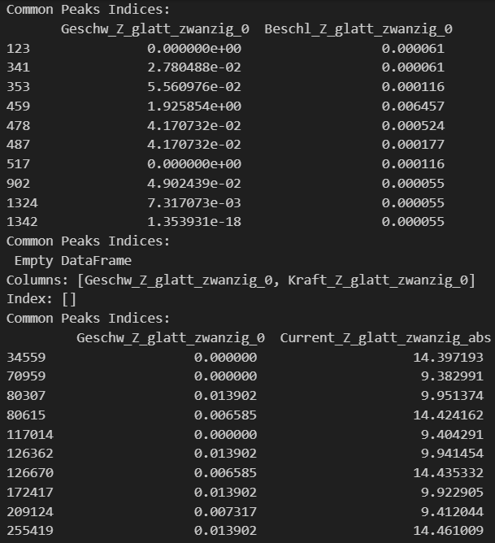

Slide 8
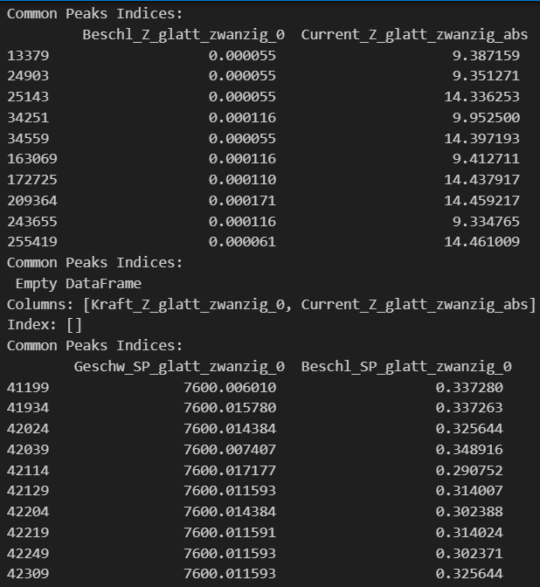
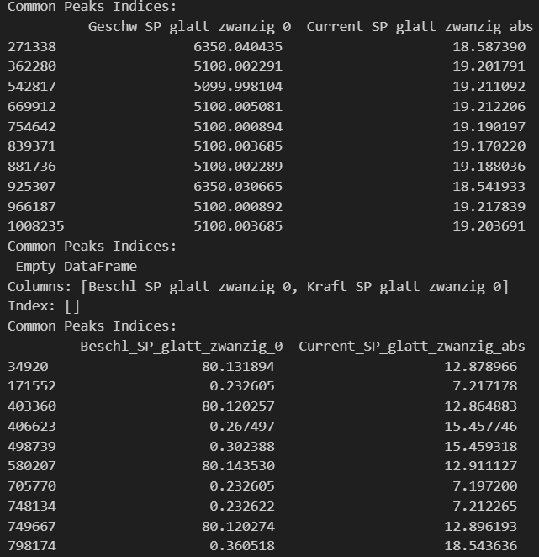

Slide 9
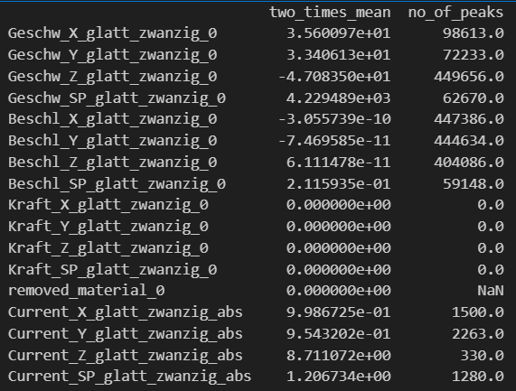
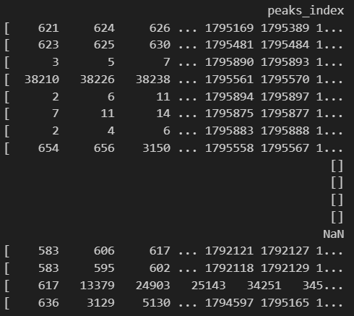
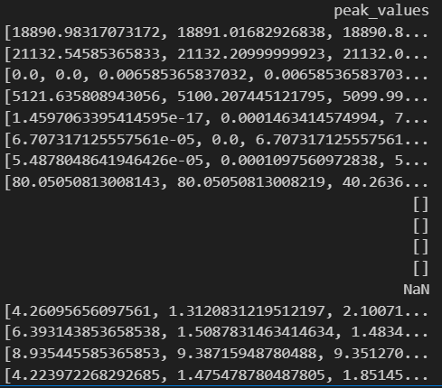
Table for every attribute, the threshold value for peaks, the number of peaks, the indices where the peaks occur, and the peak values.

Slide 10
Tables
Table for every pair of attributes in an axis, the threshold value for peaks, number of common peaks, the indices where peak occurred and the peak values.

Slide 11
X - axis
Features | Two_times_mean | No_of_peaks | Peak_indices | Peak_values
Beschl_X_glatt_zwanzig_0 | -3.055739e-10 | 21476 | [1048576, 1310726, 1179656, 1310729, 1703951, ... | [0.0002804878055563, 0.0003475609768118, 0.000...
Geschw_X_glatt_zwanzig_0 | 3.560097e+01 | 21476 | [1048576, 1310726, 1179656, 1310729, 1703951, ... | [154.10195121925116, 448.1451219513341, 140.11...
Current_X_glatt_zwanzig_abs | 0.998673 | 12 | [993859, 951811, 1035907, 1516678, 1077955, 20... | [2.300167951219512, 2.298208853658537, 2.29729...
Geschw_X_glatt_zwanzig_0 | 35.600975 | 12 | [993859, 951811, 1035907, 1516678, 1077955, 20... | [21696.14780487836, 21696.013170731687, 21696....
Beschl_X_glatt_zwanzig_0 | -3.055739e-10 | 206 | [1288194, 951811, 1467398, 61962, 297484, 1684... | [0.0005609756111126, 0.0011219512222252, 0.001...
Current_X_glatt_zwanzig_abs | 9.986725e-01 | 206 | [1288194, 951811, 1467398, 61962, 297484, 1684... | [2.2917480731707323, 2.298208853658537, 2.3228...

Slide 12
Y - axis
Features | Two_times_mean | No_of_peaks | Peak_indices | Peak_values
Beschl_Y_glatt_zwanzig_0 | -7.469585e-11 | 15162 | [163848, 819209, 163851, 819215, 819221, 16386... | [0.0001402438944595, 0.0002804878000105, 0.000...
Geschw_Y_glatt_zwanzig_0 | 3.340613e+01 | 15162 | [163848, 819209, 163851, 819215, 819221, 16386... | [170.22146341510162, 234.2634146349688, 169.85...
Current_Y_glatt_zwanzig_abs | 0.95432 | 49 | [1319552, 1368834, 1565826, 1418116, 951811, 1... | [3.025402512195121, 3.0350311707317066, 3.0012...
Geschw_Y_glatt_zwanzig_0 | 33.40613 | 49 | [1319552, 1368834, 1565826, 1418116, 951811, 1... | [17912.320243903217, 17912.370731707884, 17912...
Beschl_Y_glatt_zwanzig_0 | -7.469585e-11 | 373 | [1288194, 1124357, 837640, 151561, 1042460, 12... | [0.0009756097536343, 0.0002134146398464, 6.707...
Current_Y_glatt_zwanzig_abs | 9.543202e-01 | 373 | [1288194, 1124357, 837640, 151561, 1042460, 12... | [2.976467268292683, 0.997713536585366, 0.99717...

Slide 13
Z - axis
Features | Two_times_mean | No_of_peaks | Peak_indices | Peak_values
Beschl_Z_glatt_zwanzig_0 | 6.111478e-11 | 19458 | [1081346, 1474563, 458755, 1769476, 819203, 65... | [6.097560994875613e-05, 6.097560994876592e-05,...
Geschw_Z_glatt_zwanzig_0 | -4.708350e+01 | 19458 | [1081346, 1474563, 458755, 1769476, 819203, 65... | [0.006585365837032, 1.3539305178355568e-18, 0...
Current_Z_glatt_zwanzig_abs | 8.711072 | 85 | [1565189, 1791499, 1161742, 1035293, 1638963, ... | [9.425215560975609, 9.92744863414634, 14.32266...
Geschw_Z_glatt_zwanzig_0 | -47.083496 | 85 | [1565189, 1791499, 1161742, 1035293, 1638963, ... | [0.0, 0.0073170731938506, 0.0139024390308827, ...
Beschl_Z_glatt_zwanzig_0 | 6.111478e-11 | 59 | [1353601, 264835, 1673987, 1452165, 1565189, 1... | [0.0002378048781415, 5.4878048641934114e-05, 5...
Current_Z_glatt_zwanzig_abs | 8.711072e+00 | 59 | [1353601, 264835, 1673987, 1452165, 1565189, 1... | [14.485685048780482, 14.414324439024393, 14.41...

Slide 14
SP - axis
Features | Two_times_mean | No_of_peaks | Peak_indices | Peak_values
Beschl_SP_glatt_zwanzig_0 | 0.211593 | 2574 | [180228, 229380, 925704, 409610, 458762, 18024... | [0.290768971883442, 0.2907350883997127, 0.2907...
Geschw_SP_glatt_zwanzig_0 | 4229.489005 | 2574 | [180228, 229380, 925704, 409610, 458762, 18024... | [7600.017174796345, 7600.01438617994, 7600.018...
Current_SP_glatt_zwanzig_abs | 1.206734 | 28 | [1525120, 1353615, 1746203, 1598749, 362280, 1... | [14.990067707317074, 16.34168378048781, 17.568...
Geschw_SP_glatt_zwanzig_0 | 4229.489005 | 28 | [1525120, 1353615, 1746203, 1598749, 362280, 1... | [4250.017491869896, 6349.983213414989, 5300.02...
Beschl_SP_glatt_zwanzig_0 | 0.211593 | 28 | [1374860, 1473424, 1452179, 403360, 171552, 91... | [80.02723577235767, 80.0621273712751, 0.255877...
Current_SP_glatt_zwanzig_abs | 1.206734 | 28 | [1374860, 1473424, 1452179, 403360, 171552, 91... | [10.05436002439024, 10.084621536585365, 16.341...

Slide 15
Plots
General Peaks of each feature over different axis

Slide 16
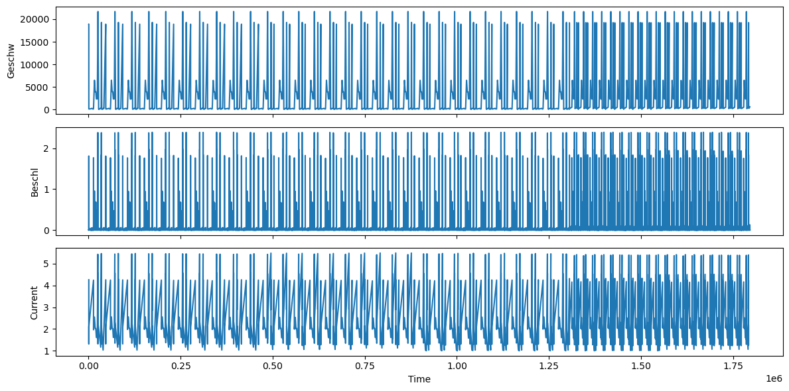
Peaks on X axis

Slide 17
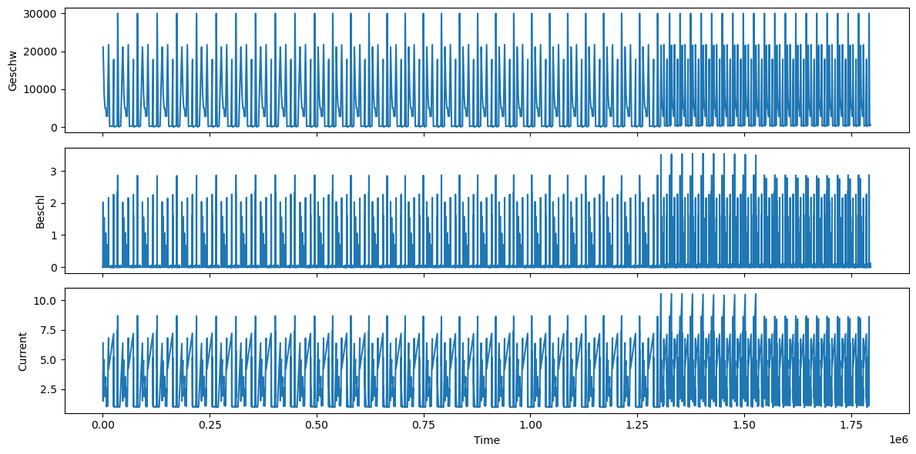
Peaks on Y axis

Slide 18
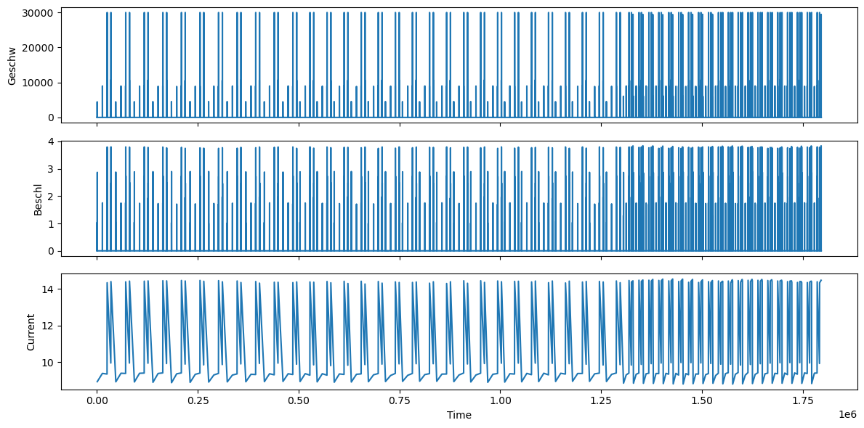
Peaks on Z axis

Slide 19
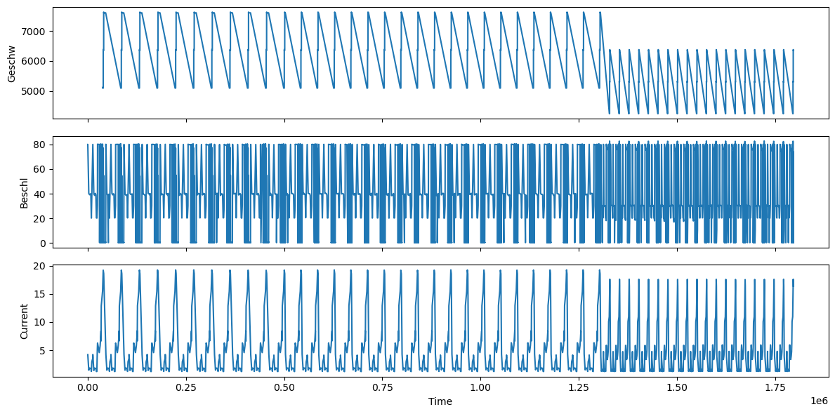
Peaks on SP axis

Slide 20
Plots
Plots for common peaks of feature-pairs over different axis

Slide 21
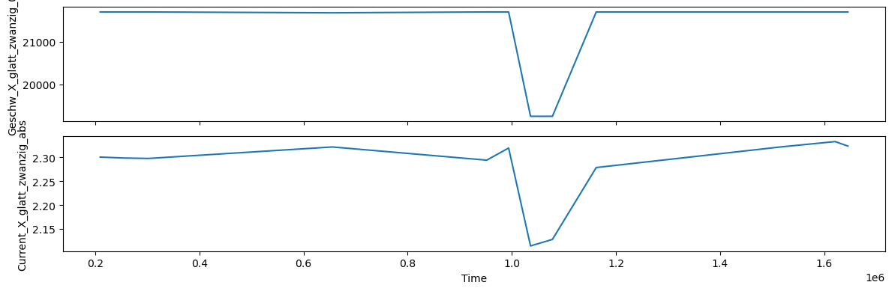
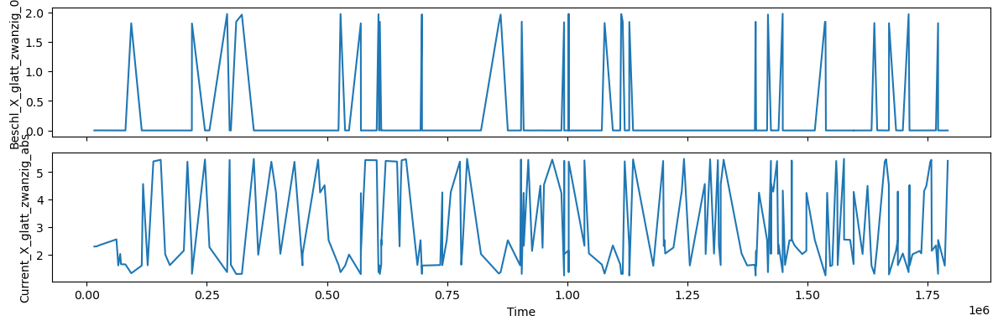
X-axis

Slide 22
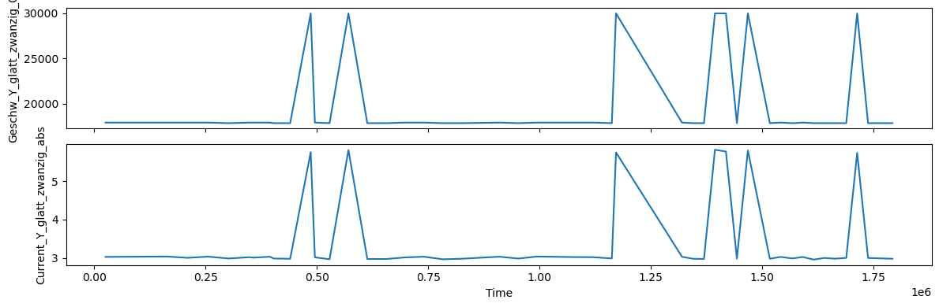
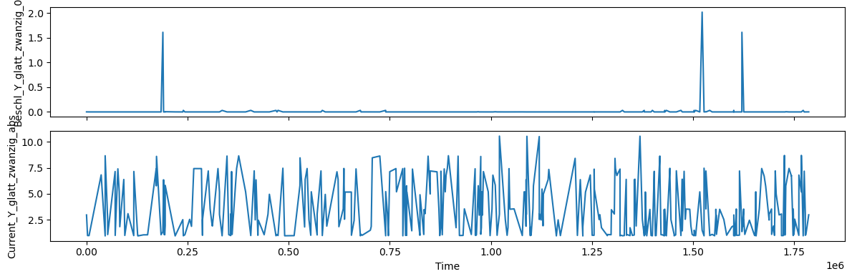
Y-axis

Slide 23
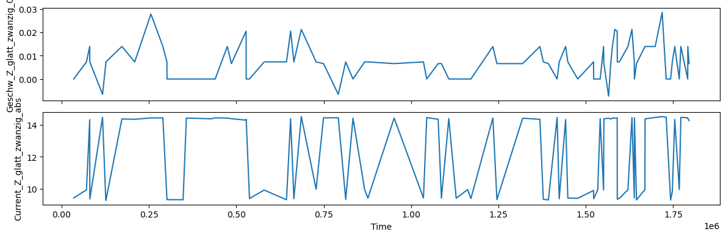
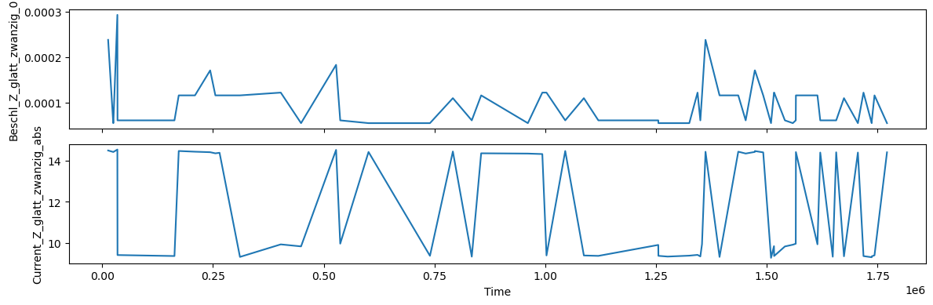
Z-axis

Slide 24
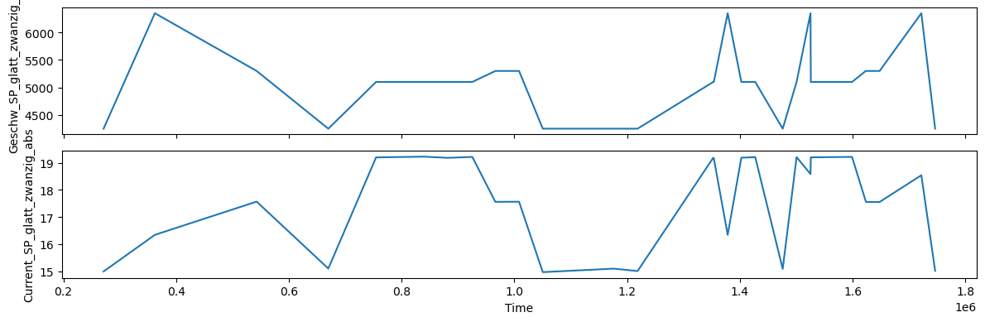
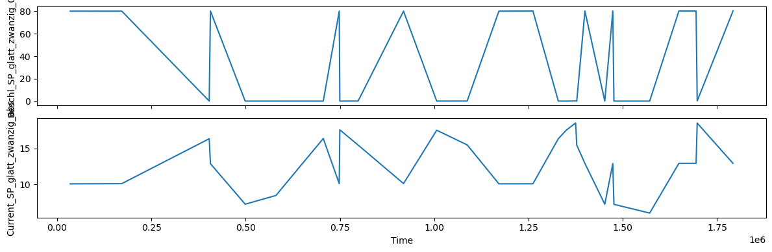
SP-axis

Slide 25
Peaks using Z-score
Algorithm setting:
lag = 1000
threshold = 15
influence = 0

Slide 26
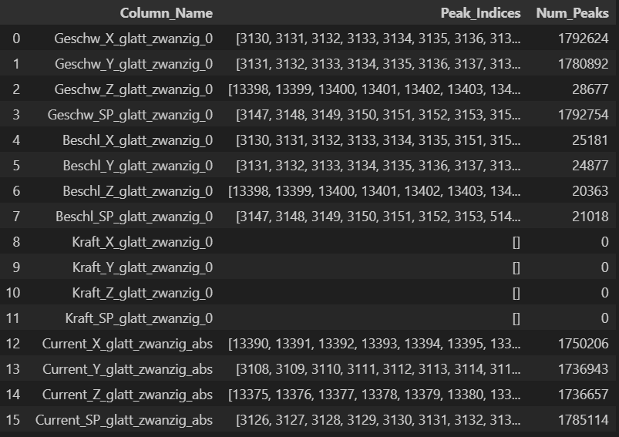
Table of Peak Info

Slide 27
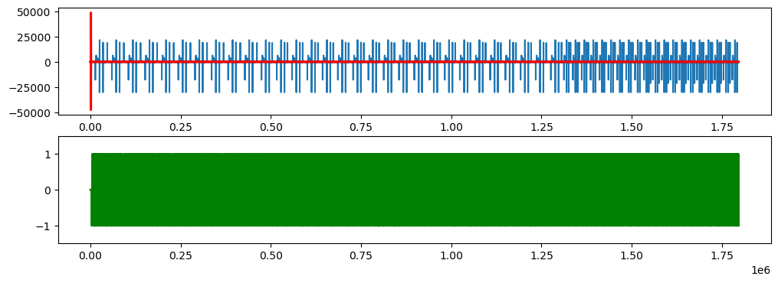
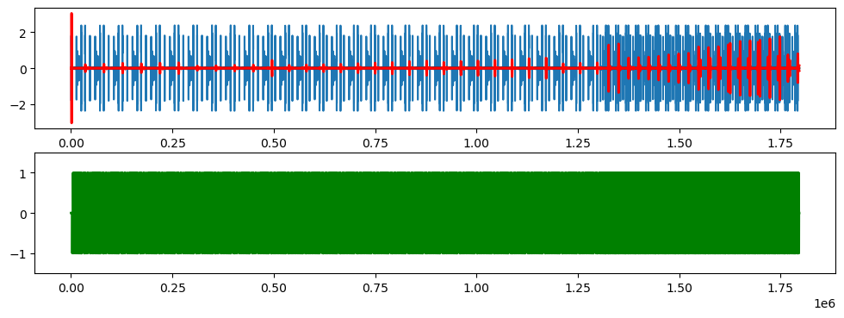
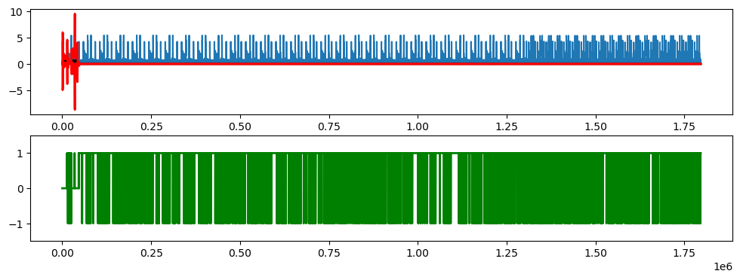
X-axis

Slide 28
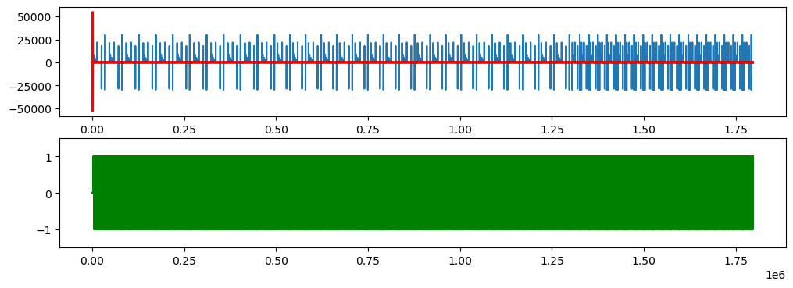
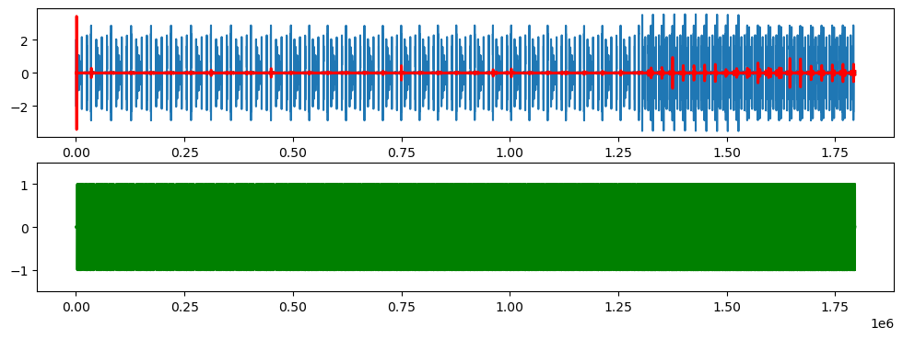
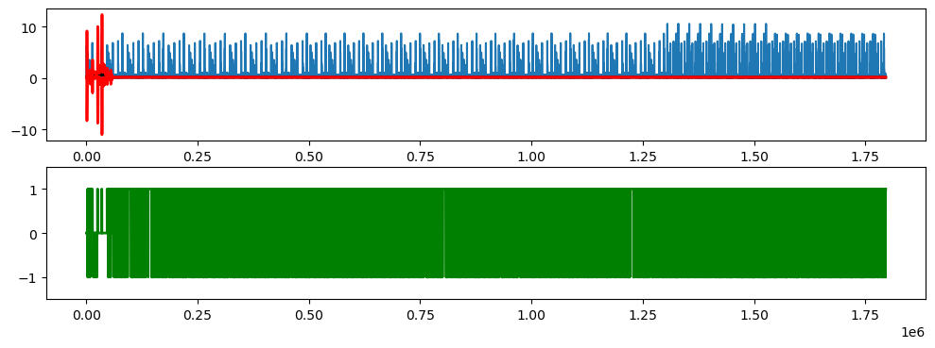
Y-axis

Slide 29
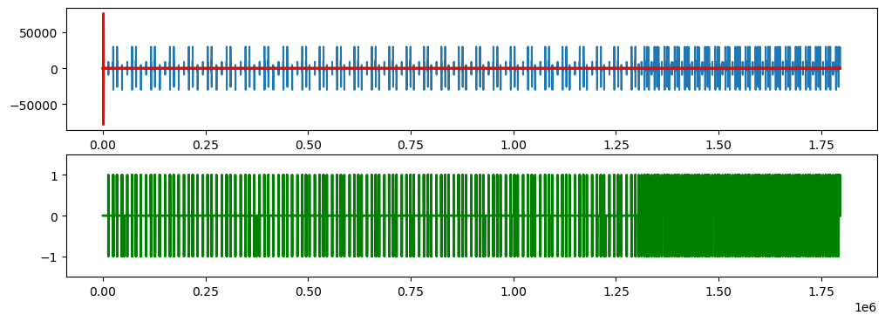
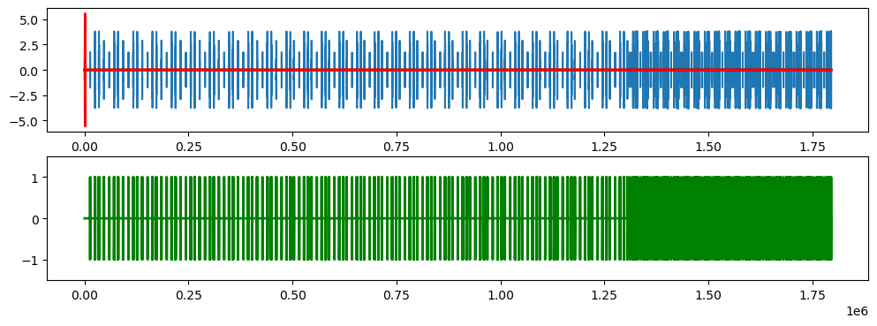
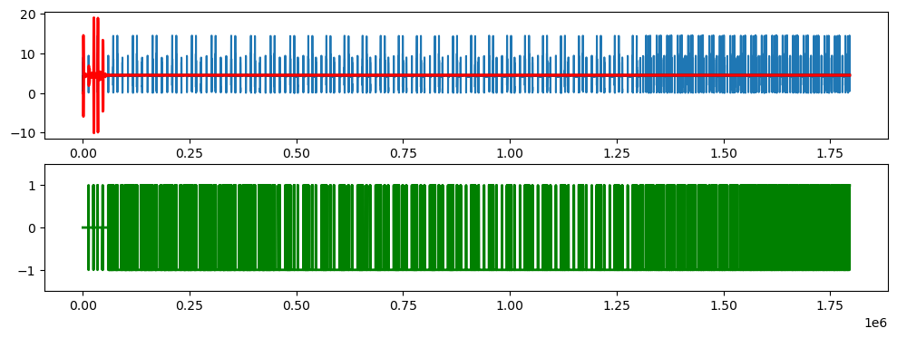
Z-axis

Slide 30
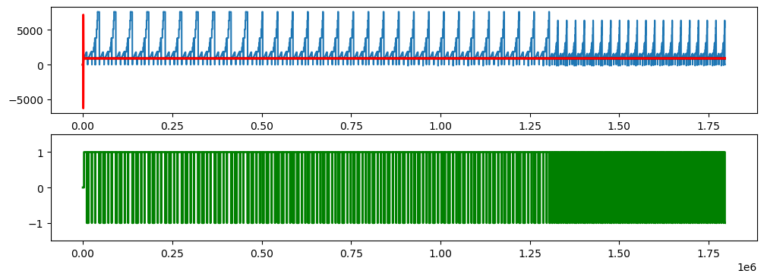
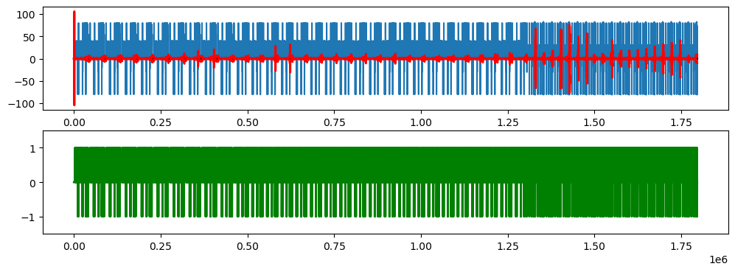
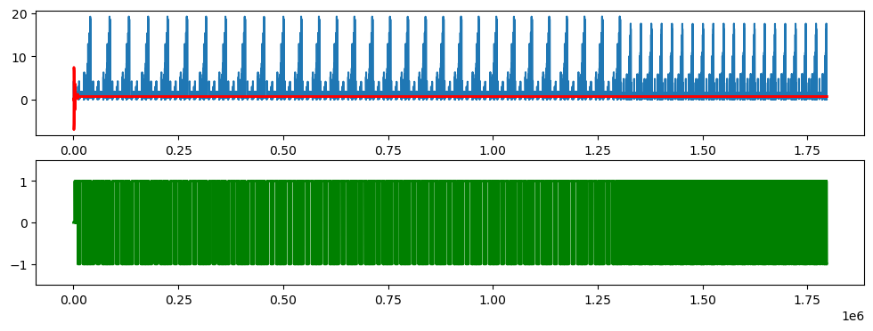
SP-axis

Slide 31
Machine Learning Models
1. LightGBM
2. CatBoost
3.Linear Regression
4. XGBoost
5. RandomForest
6. SVM
7. Neural Nets

Slide 32
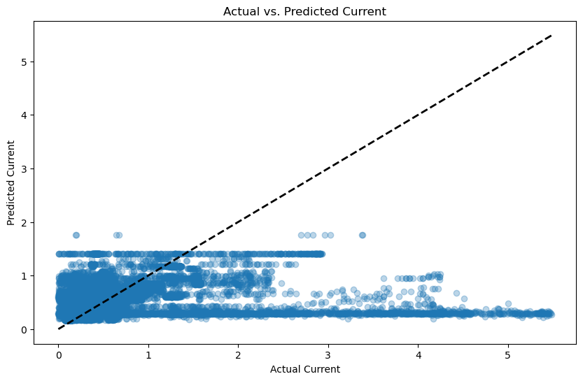
LightGBM

Slide 33
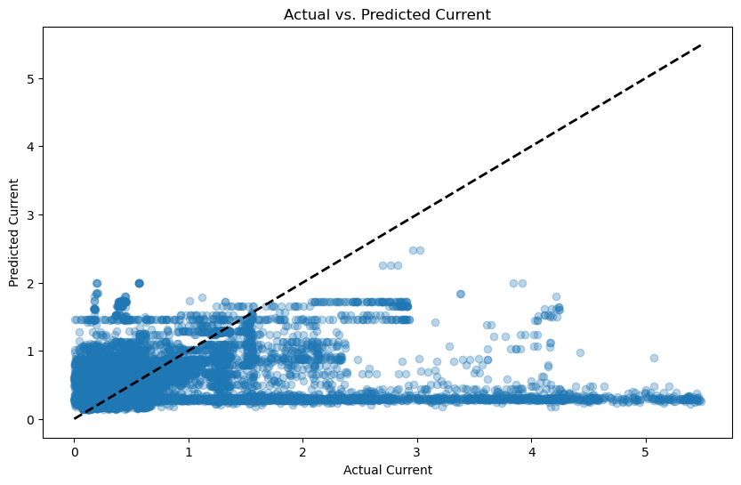
CatBoost

Slide 34
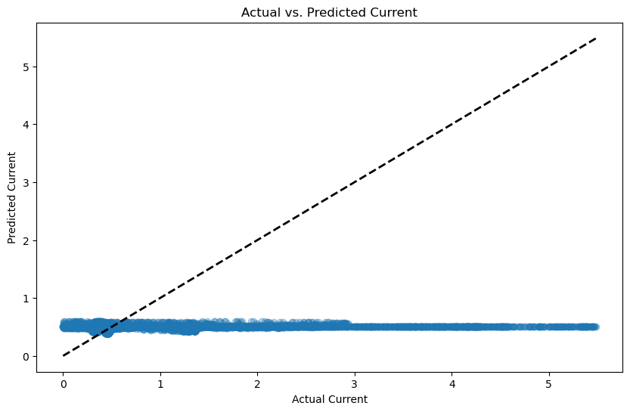
Linear Regression

Slide 35

XGBoost Regressor

Slide 36
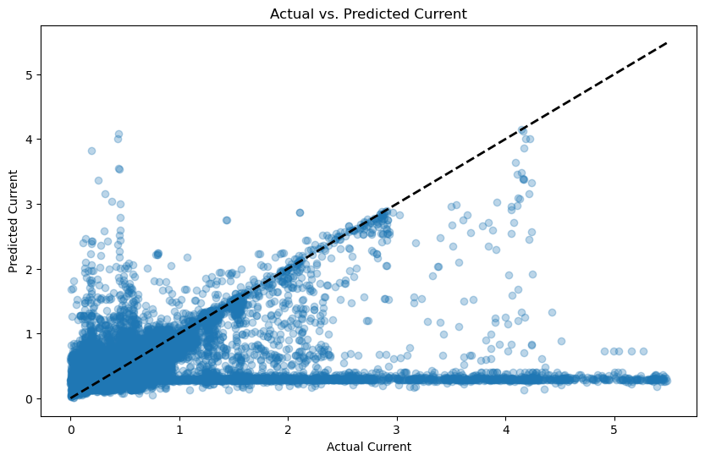
Random Forest

Slide 37
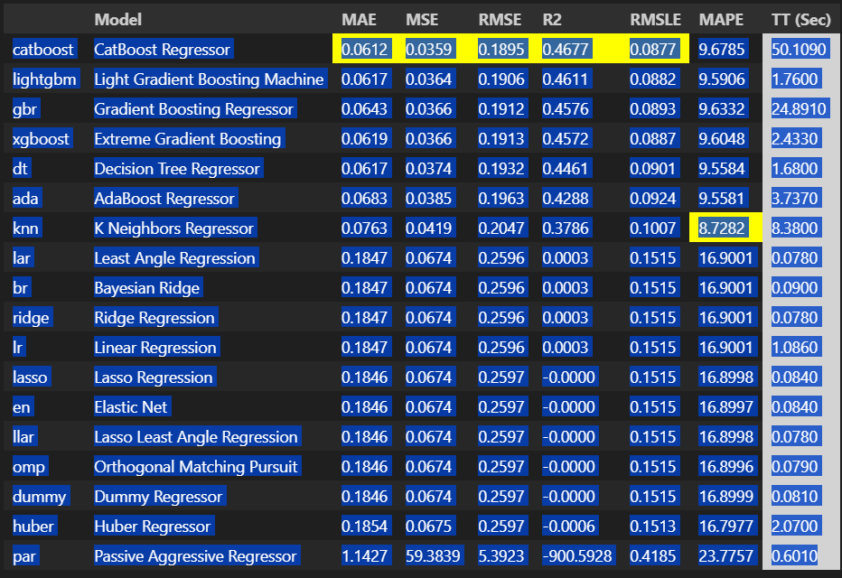
PyCaret

Slide 38
Identifying Repetitions
Autocorrelation Analysis
MatrixProfiling
Seasonal Decomposition?

Slide 39
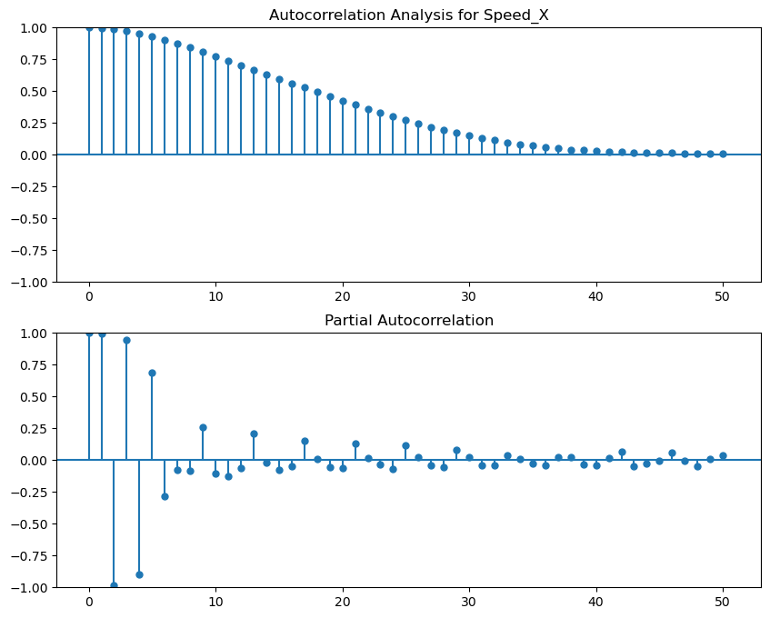

Slide 40
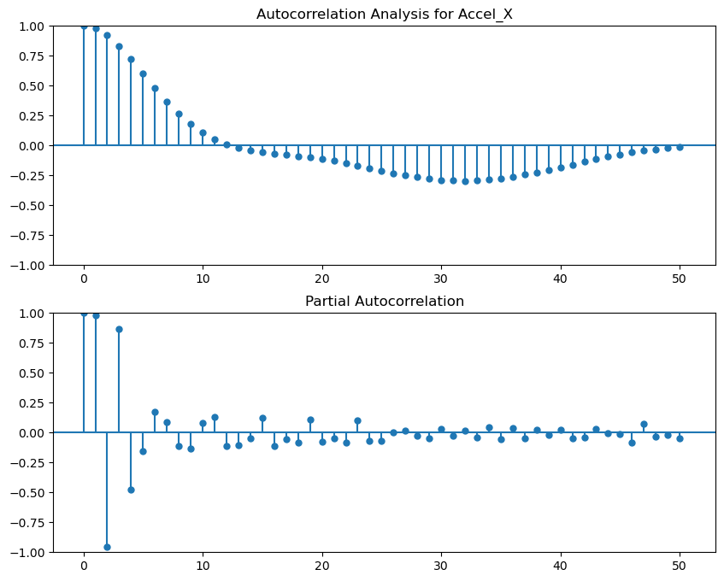

Slide 41
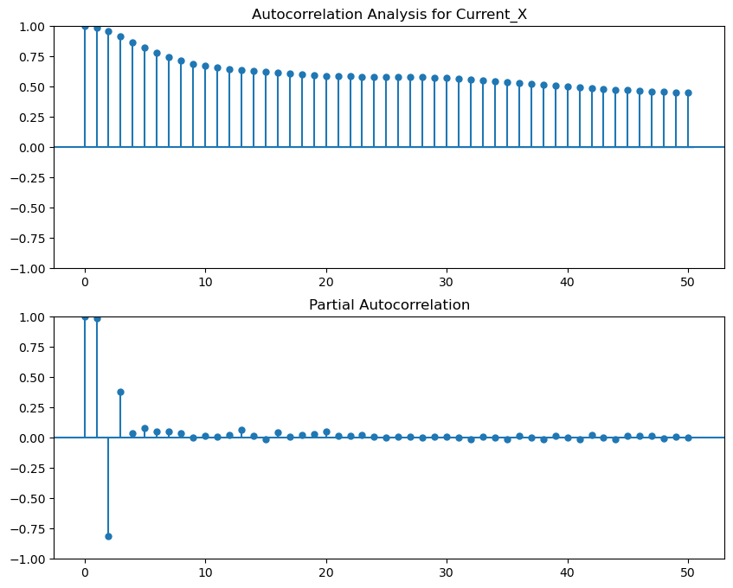

Slide 42
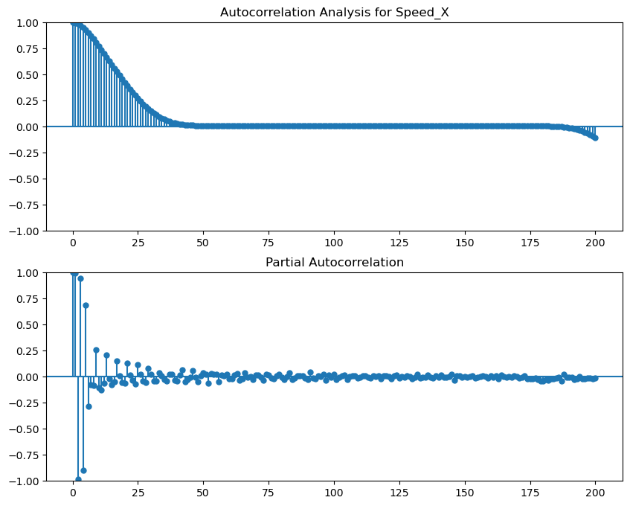

Slide 43
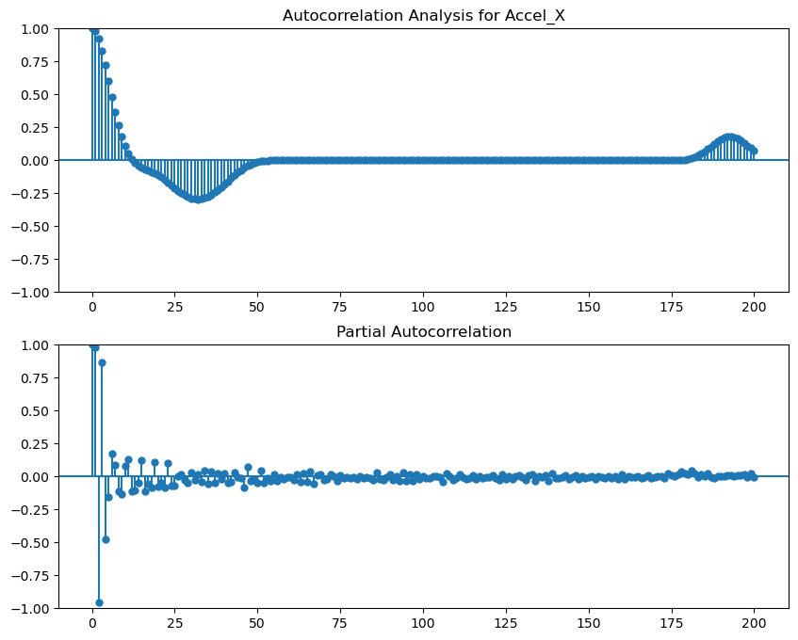

Slide 44
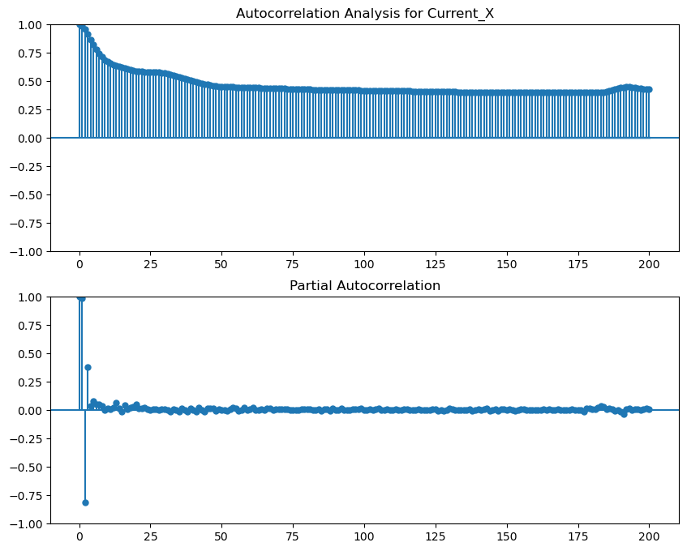

Slide 45
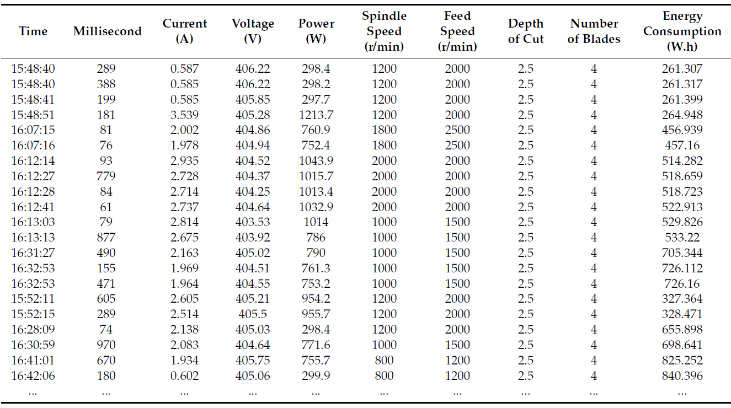
Important features for predicting Energy Consumption

Slide 46
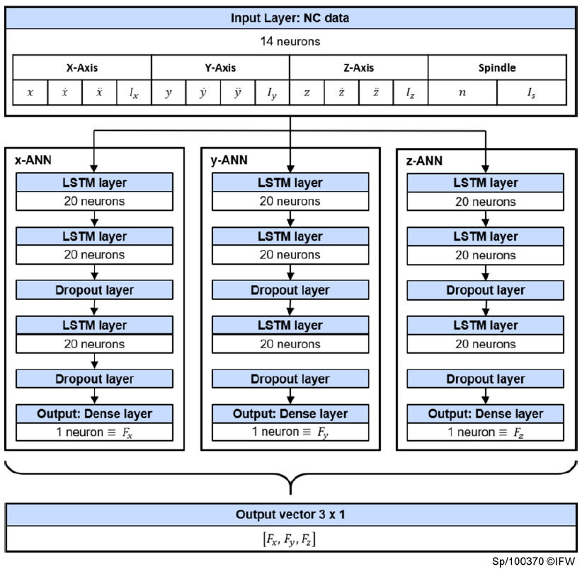

Slide 47
The power requirements of a milling process are divided into the following consumer groups:
Cooling lubricant processing
Compressed air generation
Electrically powered auxiliary components of the milling machine
CNC control package with main spindle and feed axis motors

Slide 48
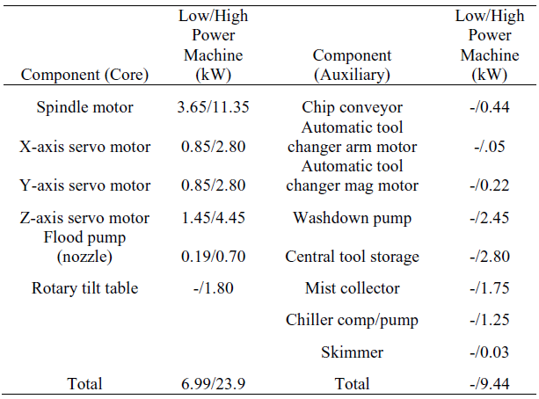

Slide 49
The deviation of the predictions for the peaks are posed on several reasons concerning especially the energy consumption of CNC machine tools and the milling process :
There are NC instructions, which are directly followed by an identical copy of themselves, whereas only one of those instructions leads to an significant energy consumption of the machining operation. This is a challenge in data acquisition, which leads to high prediction errors: Having two identical inputs generating highly different energy consumption, the model has to average the output and produce high errors.
Despite being similar, NC instructions can differ in energy consumption. For example the energy needed for the tool change system is dependent on the position in the tool magazine.

